Slide 1

Reinforcement Learning
RL teaches an AI agent how to play a game
Simulates “Cause-and-effect”
RL is unsupervised
Agent makes decision based on policy or randomness
Learning uses a “Q-value” for each possible action the AI can take, given a particular state of the game.
Success or failure influences the Q-value for actions actually taken.

Slide 2
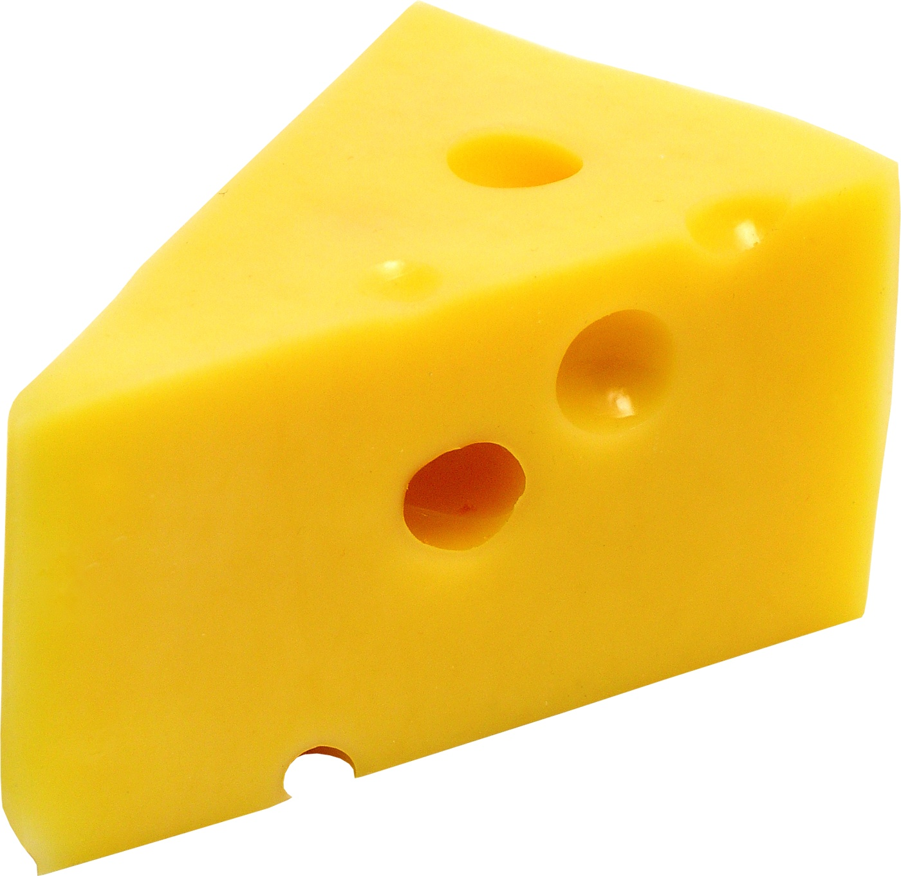
RL: Goals
Produce intelligent “agents”
Provide challenging gameplay
Add replay value
Respond to player's style and choices
Avoid repeating mistakes
“Cause-and-effect”

Slide 3

RL: Benefits
Can be used offline or online – or both!
Agents provide challenging gameplay
Learning based on gameplay can add replay value
RL can respond to player's actions
RL can provide better challenges
“Game state” representation is arbitrary
Pick and choose the parameters you think should apply
Represent only the state that applies to RL agent

Slide 4

RL Challenges
Balance new choices vs. learned choices
Learned methods are proven effective, but...
Might not be so effective against new situations
Use randomness to introduce new methods
Many learning iterations (epochs) are required
Can “pre-bake” a smart agent, use gameplay for subtle changes
“Game state” representation is arbitrary
Must represent all possible combinations
Memory storage: size vs. speed

